Slide 1

Howard Shore’s use of Musical Devices in his Score for The Lord of the Rings
Nathan Guth

Slide 2
Topic and Motivation

Slide 3
Choosing a Topic & Initial Ideas
Music
Film music
Use of film music
The Lord of the Rings
Final Idea
“Howard Shore’s use of Musical Devices in his Score for The Lord of the Rings”

Slide 4
Objectives
To focus on a few select themes
Identify occurrences of these motifs in the films and soundtrack
Using the performances of these themes, observe how Howard Shore modified his original ideas
How does this affect the audience/movie itself

Slide 5
Brief Overview

Slide 6
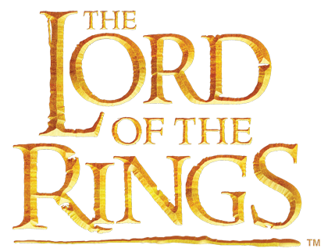
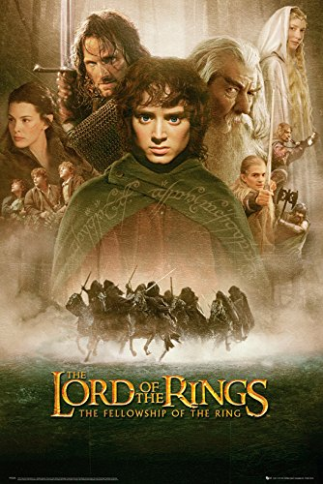
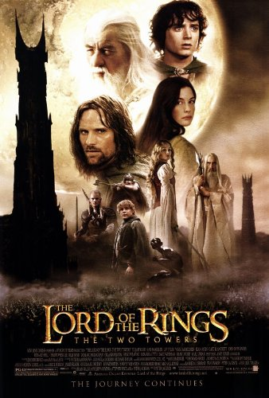
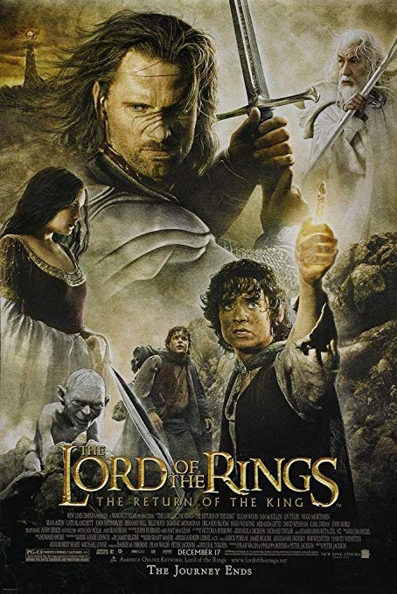
The Lord of the Rings by Peter Jackson
About the trilogy
Some of the biggest and most ambitious film projects ever undertaken.
3 films shot simultaneously
Over $2.92billion at the box office (amongst the highest of all time)
Won 17 out of 30 Academy Award nominations
Return of the King won all 11 of its nominations.

Slide 7
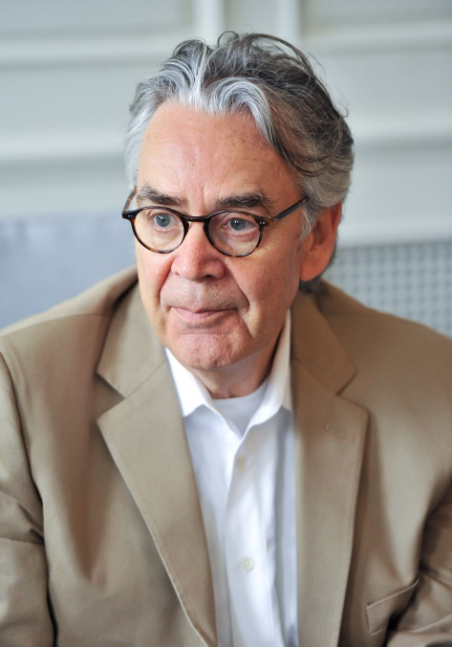
The Lord of the Rings by Howard Shore
About the soundtrack
How Great?
More than 12 hours of recorded music
Over 100 unique and identifiable themes
Unusual instrumentation
Featured soloists
Multitude of musical styles
120 players in the London Philharmonic Orchestra
Earned
3 Oscars
2 Golden Globes
3 Grammys
Voted best soundtrack in film history (Classic FM)

Slide 8
Process
TALK ABOUT SOURCEs
PRIMARY & SECONDARY

Slide 9
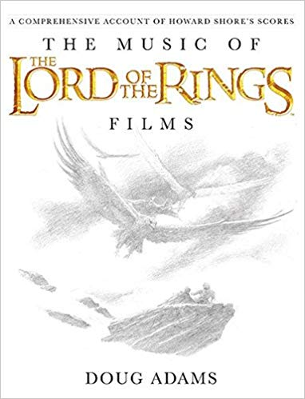
Sources

Slide 10
The Leitmotif
A quick overview:
A recurring musical theme or idea
Attach a particular theme to a part of the narrative:
Character
Location
Emotion
Event
Objects
Notion/Theme
Modify and combine themes

Slide 11
A Few Examples
The Imperial March Star Wars – John Williams
Shark motif Jaws – John Williams
James Bond 007 franchise – Monty Normand & John Barry
Harry Potter Harry Potter - John Williams
Back to the Future fanfare Back to the Future – Alan Silvestri
The Dark Knight The Dark Knight – Hans Williams
The Good, The Bad and The Ugly The Good The Bad and The Ugly Ennio Morricone
Time Inception – Hans Zimmer
And countless others

Slide 12
Structure

Slide 13
My Chosen Leitmotifs
Focus on 3 main motifs:
The Shire
Location Theme
The Fellowship
Group of characters
Gondor & Men in Middle-Earth
Location Theme AND idea/notion theme
Task:
To explore the different versions of each theme
Relate to events in film and narrative

Slide 15
Learning

Slide 16
Conclusion

